Slide 1
caArray User Interface Review
2.0 Wireframe Discussion
September 28, 2007

Slide 2
Agenda
Present Updates to What We Saw Last Time
  Navigation, Search, Logged in View
  Data Management
  Experiment Management
  Extraction
  Permissions

Slide 3
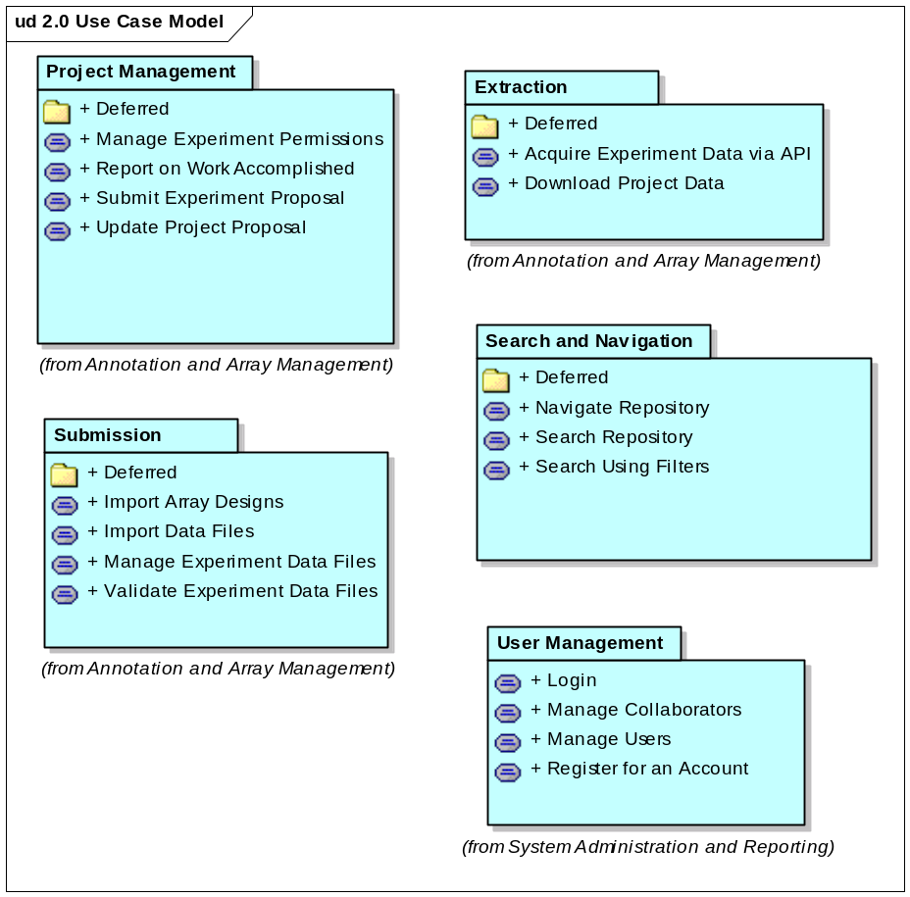
What We’ll Cover Today

Slide 4
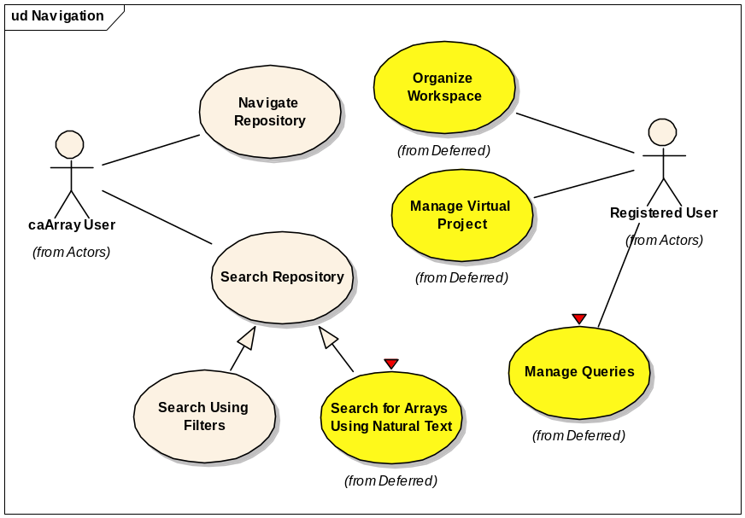
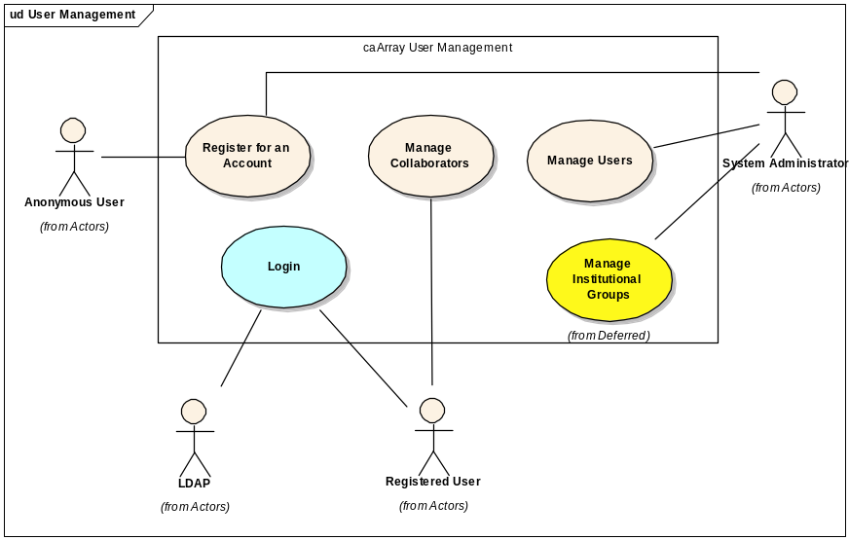
Navigation and Search

Slide 5
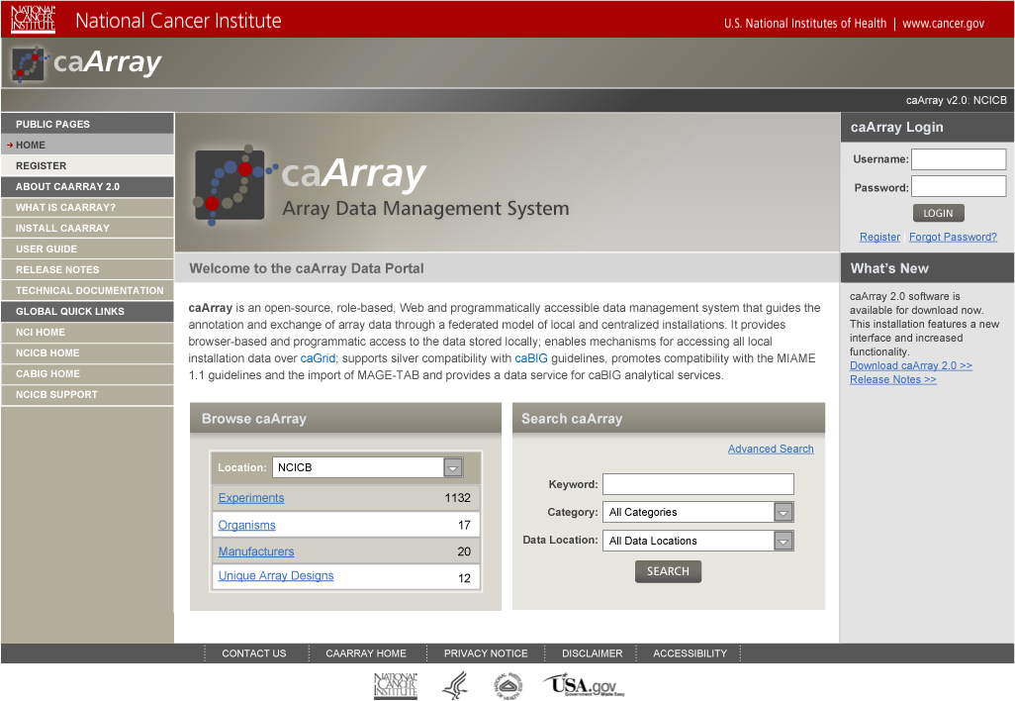
Navigate Repository
1
2
Notes:
Represents the home page and navigational orientation
Menus are role dependent but able to represent multiple role actions
Availab

Slide 6
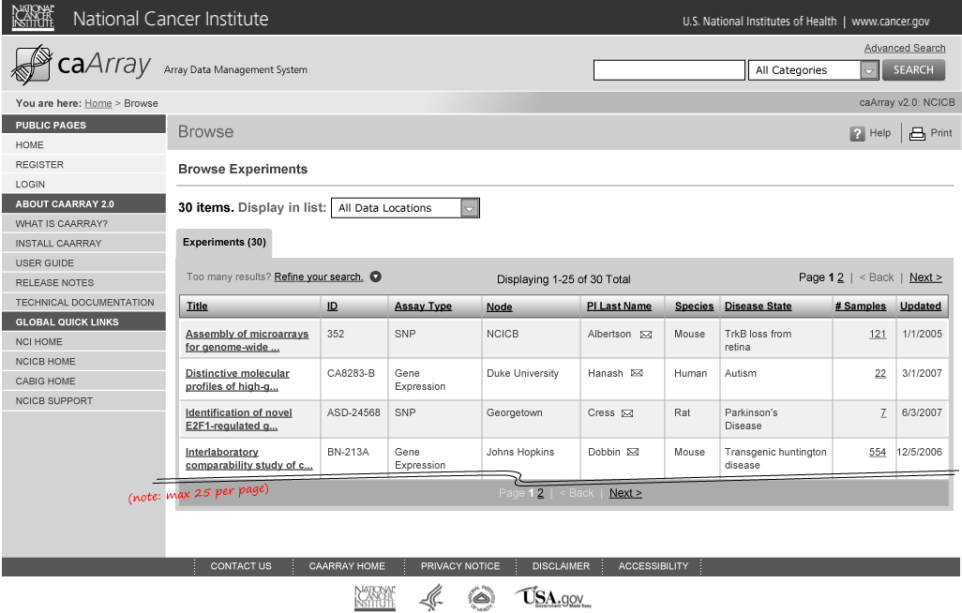
Browse by Category and Results

Slide 7
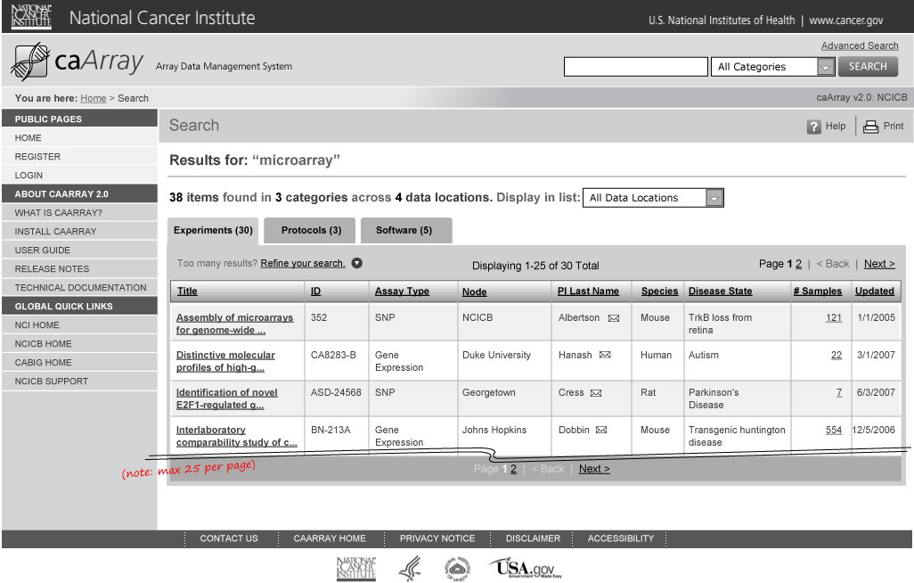
Search and Search Results

Slide 8
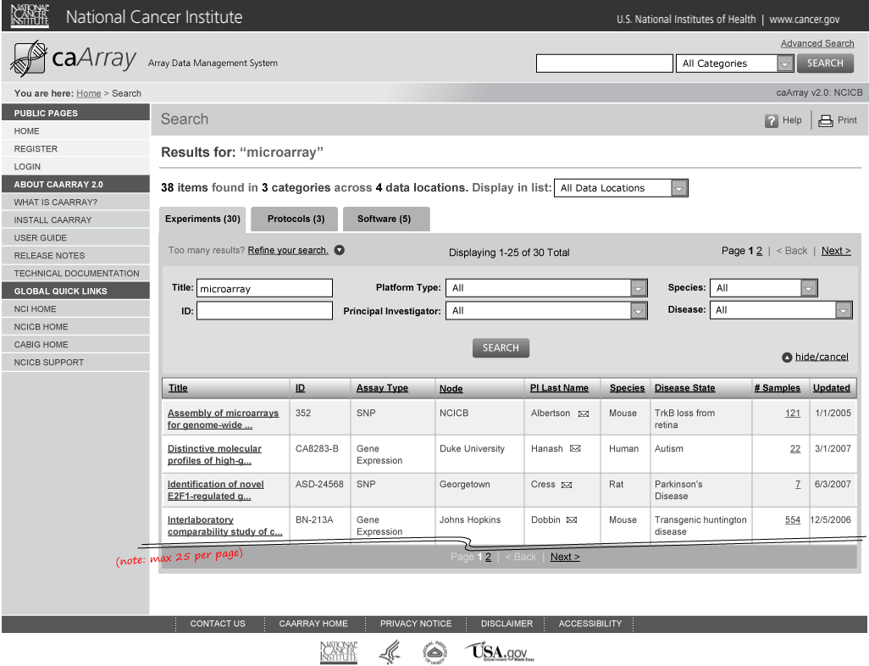
Search and Search Results: Refine Results

Slide 9
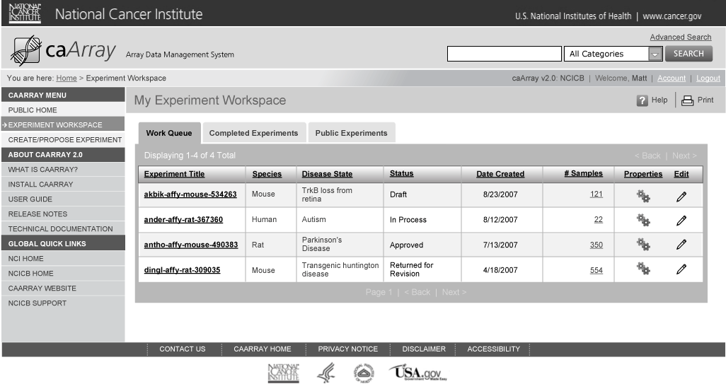
Login – Experiment Workspace

Slide 10
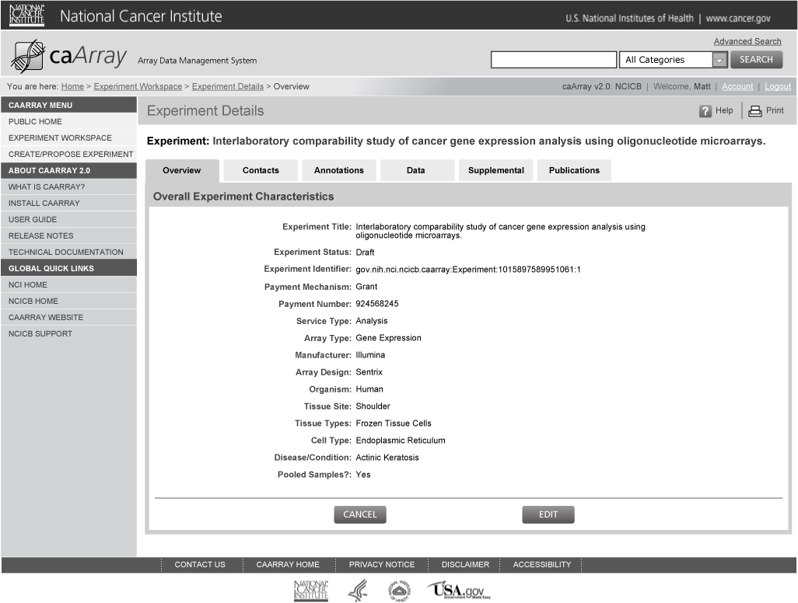
View Experiment Details

Slide 11
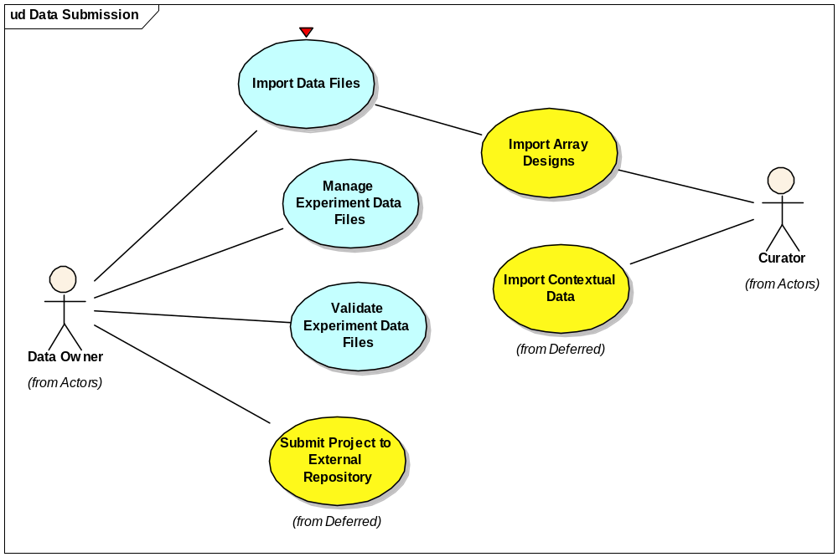
Managing Data Submission

Slide 12
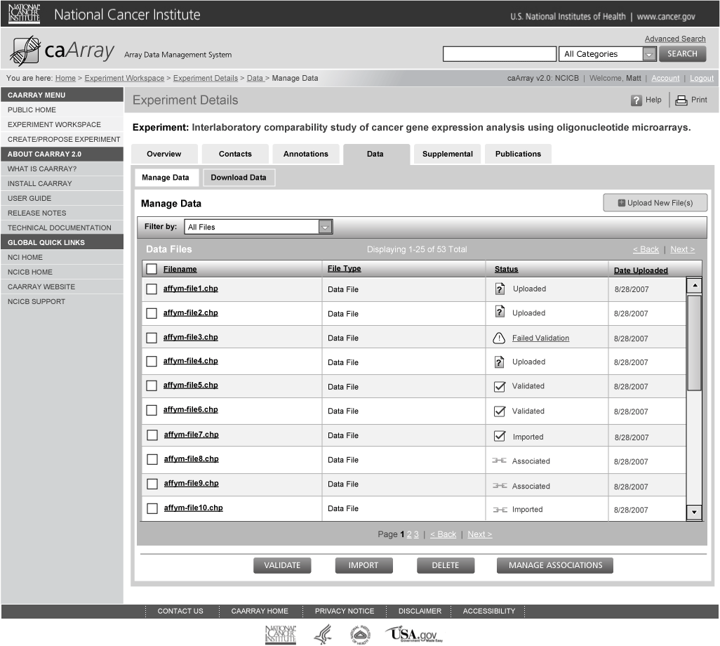
Manage Experiment Data

Slide 13
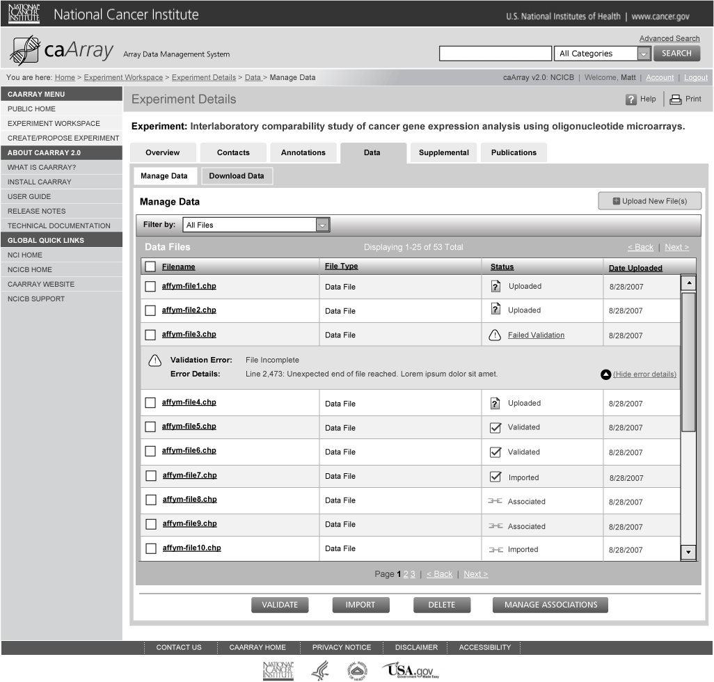
Manage Experiment Data: Import/Validate

Slide 14
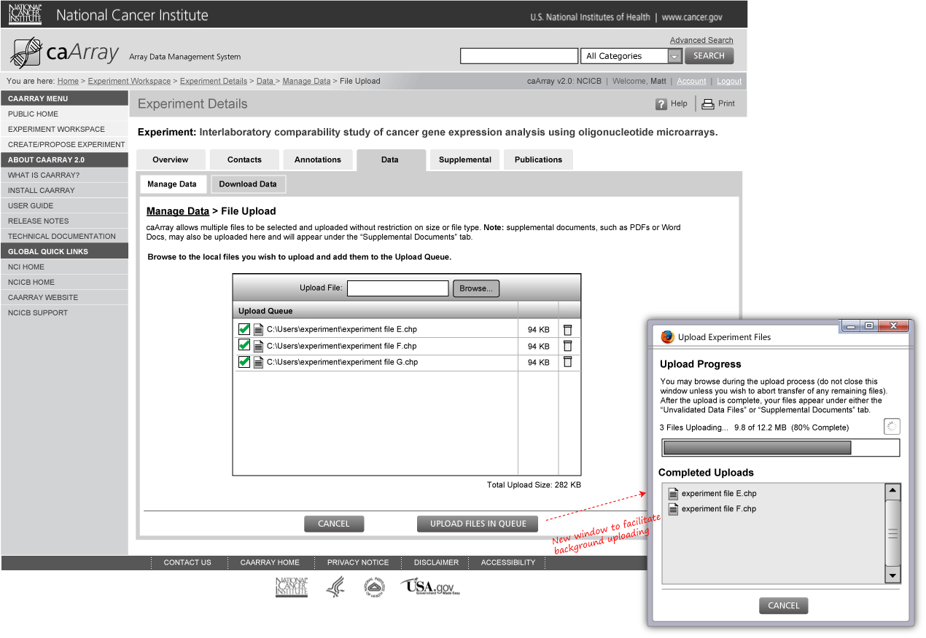
Manage Experiment Data: Upload

Slide 15
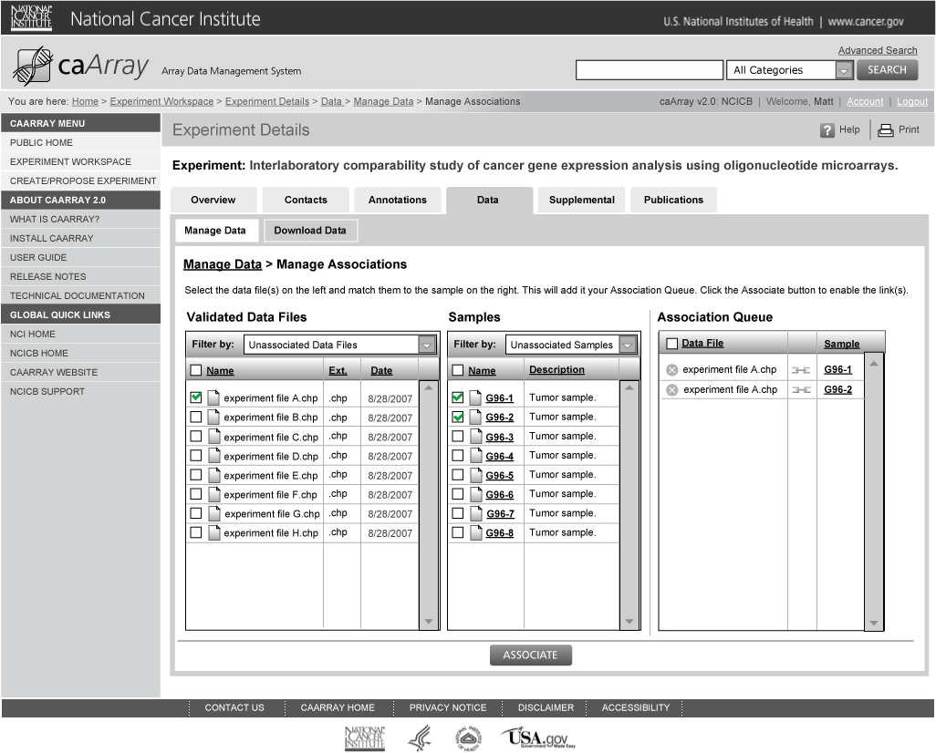
Manage Experiment Data: Link Uploaded Data Files to Samples

Slide 16
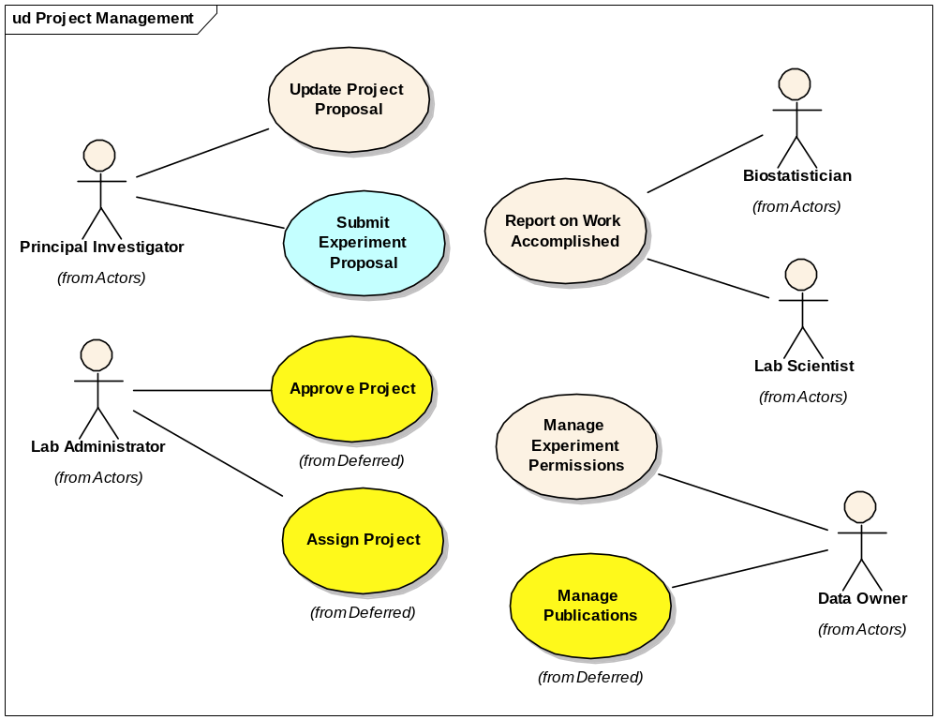
Experiment Management

Slide 17
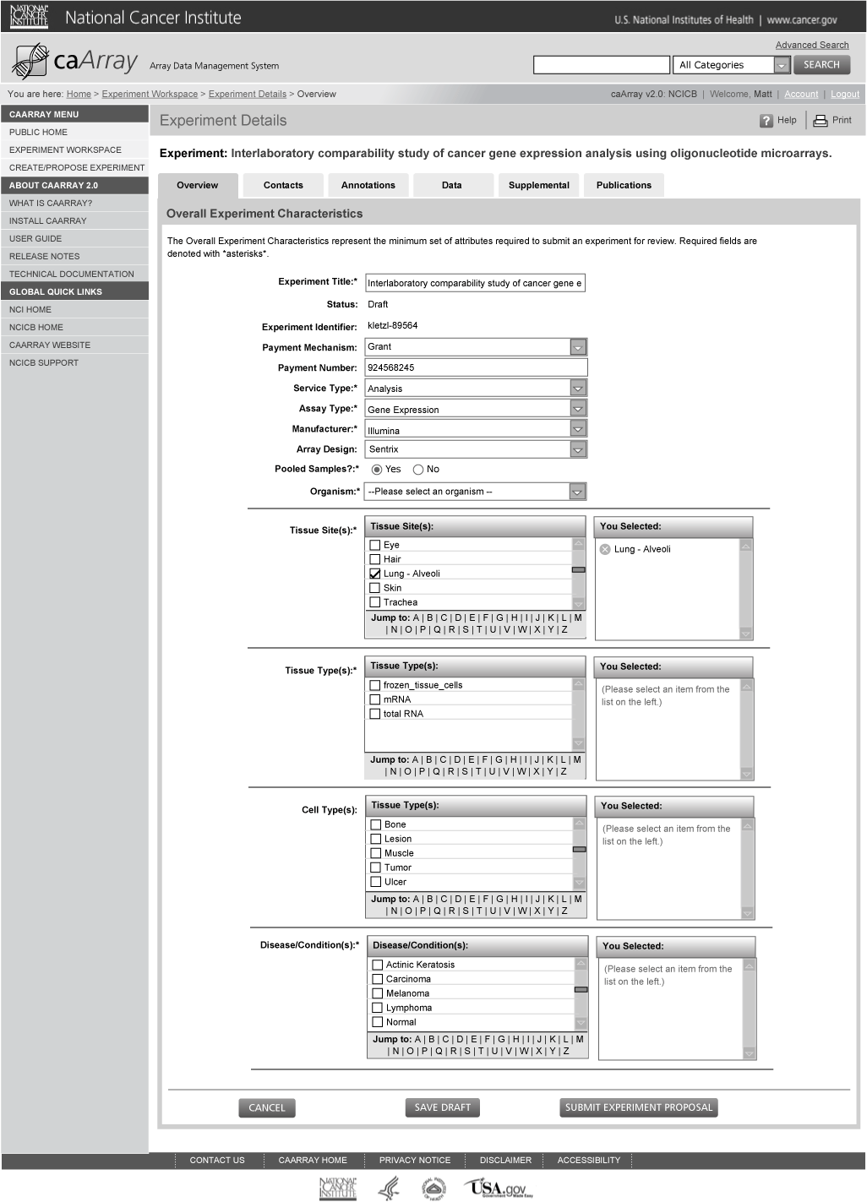
Submit Experiment Proposal: Overview

Slide 18
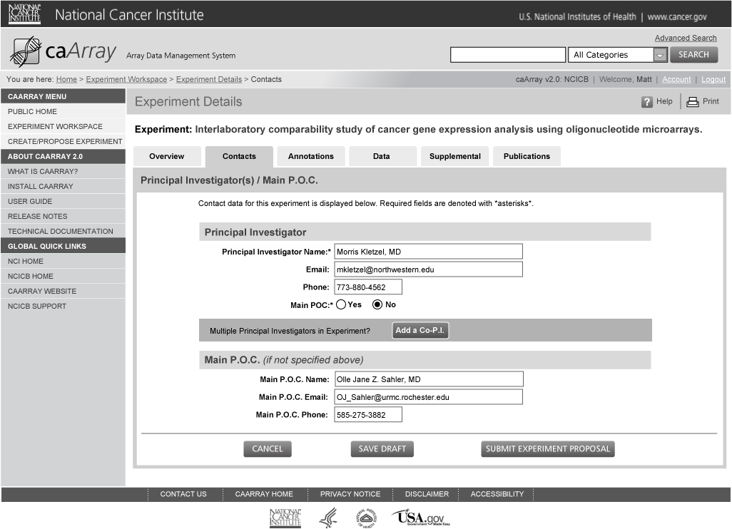
Submit Experiment Proposal: P.I. / Main P.O.C Contact Information

Slide 19
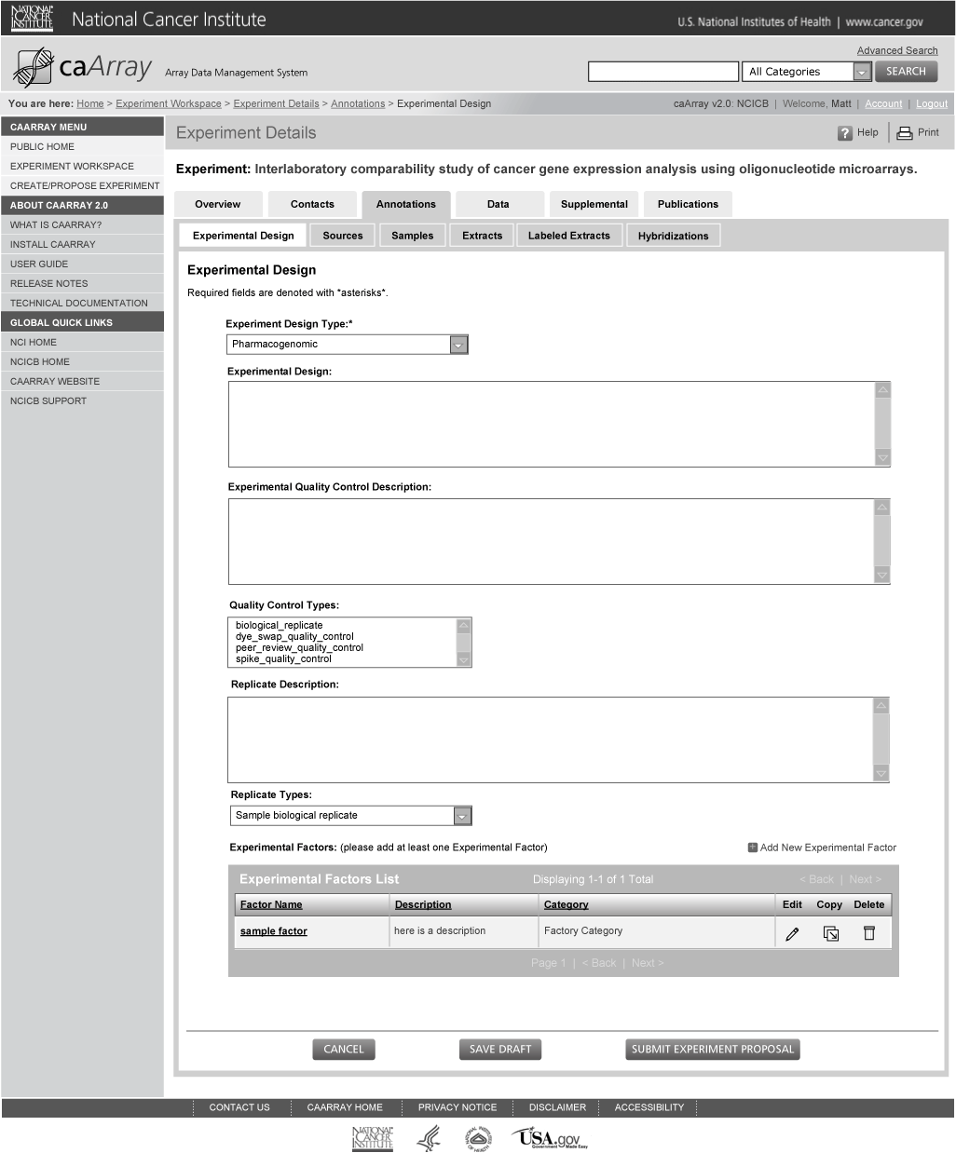
Submit Experiment Proposal: Edit Experimental Design

Slide 20
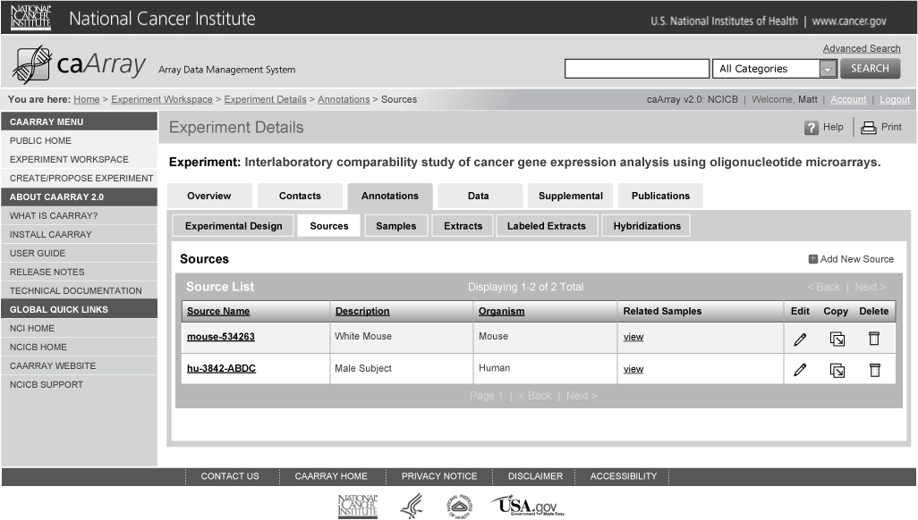
Submit Experiment Proposal: Experiment Data: Sources List

Slide 21
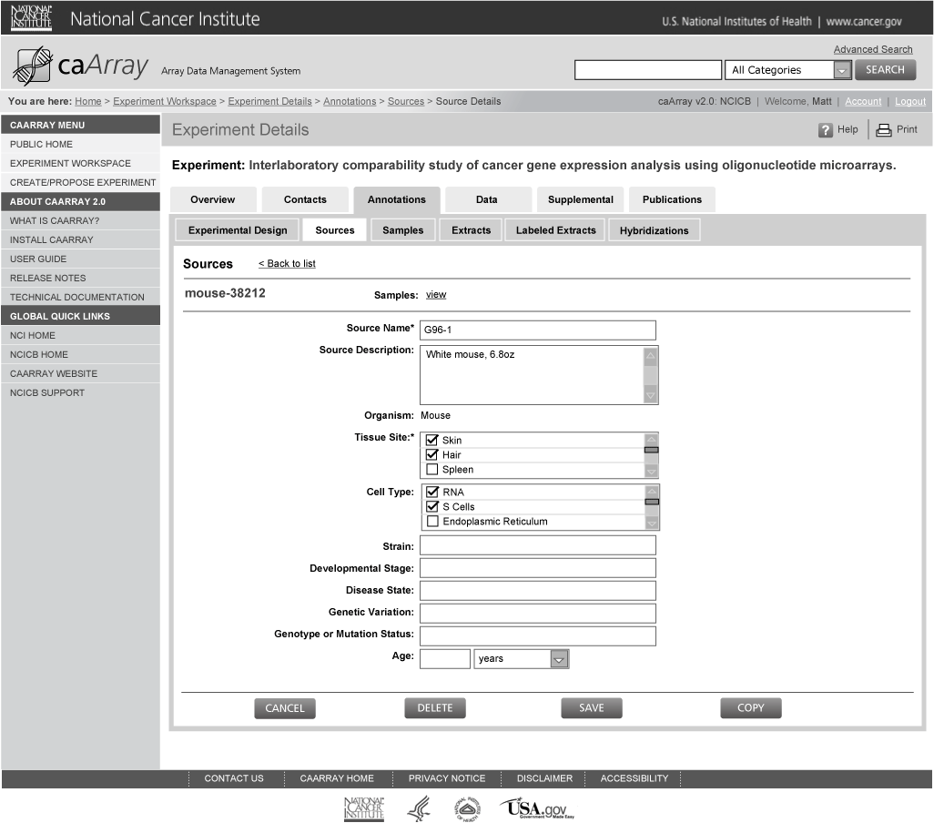
Submit Experiment Proposal: Edit Experiment Data: Sources

Slide 22
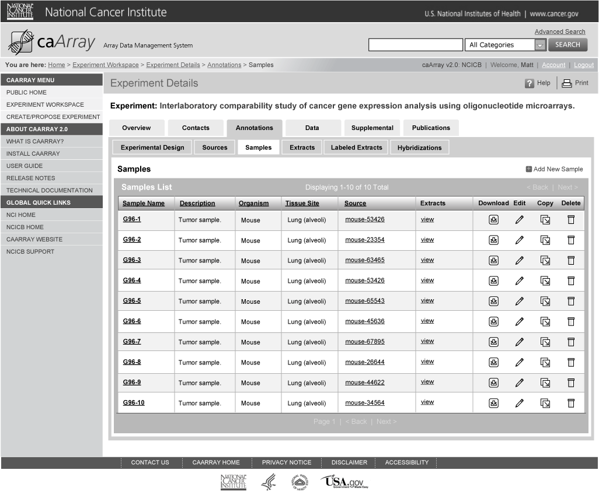
Submit Experiment Proposal: Experiment Data: Samples List

Slide 23
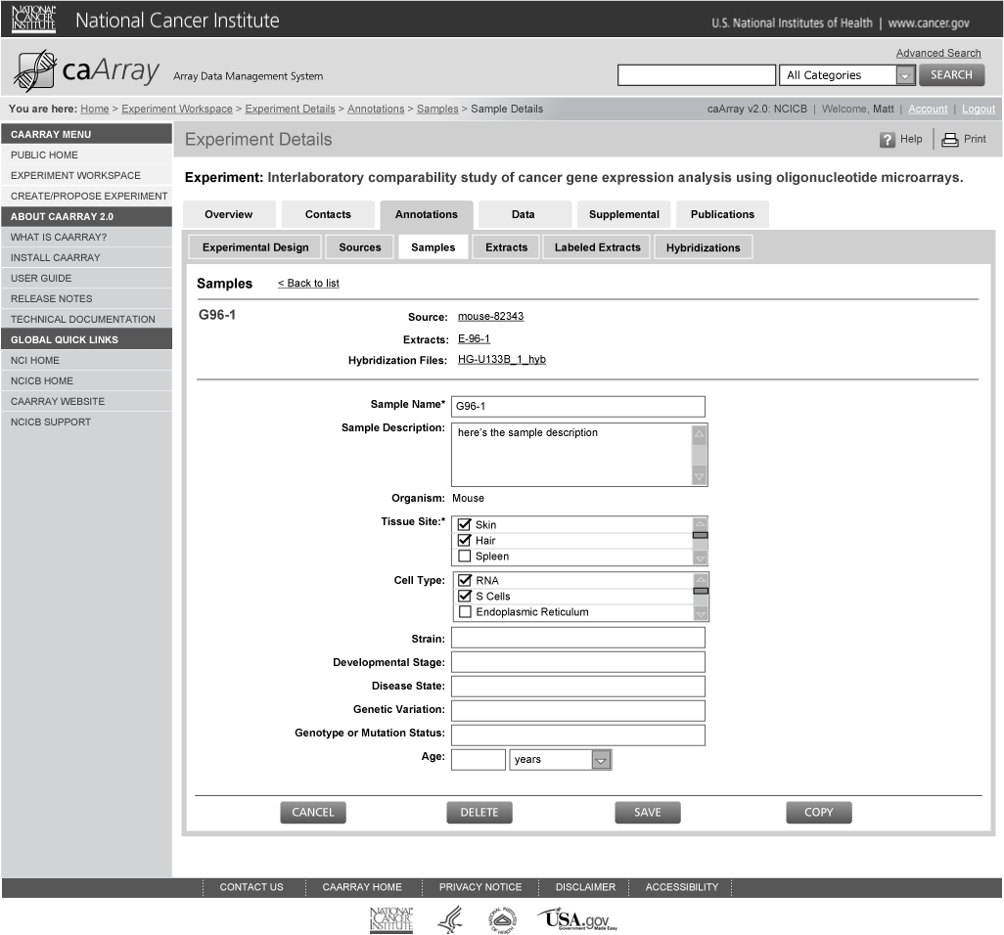
Submit Experiment Proposal: Edit Experiment Data: Samples

Slide 24
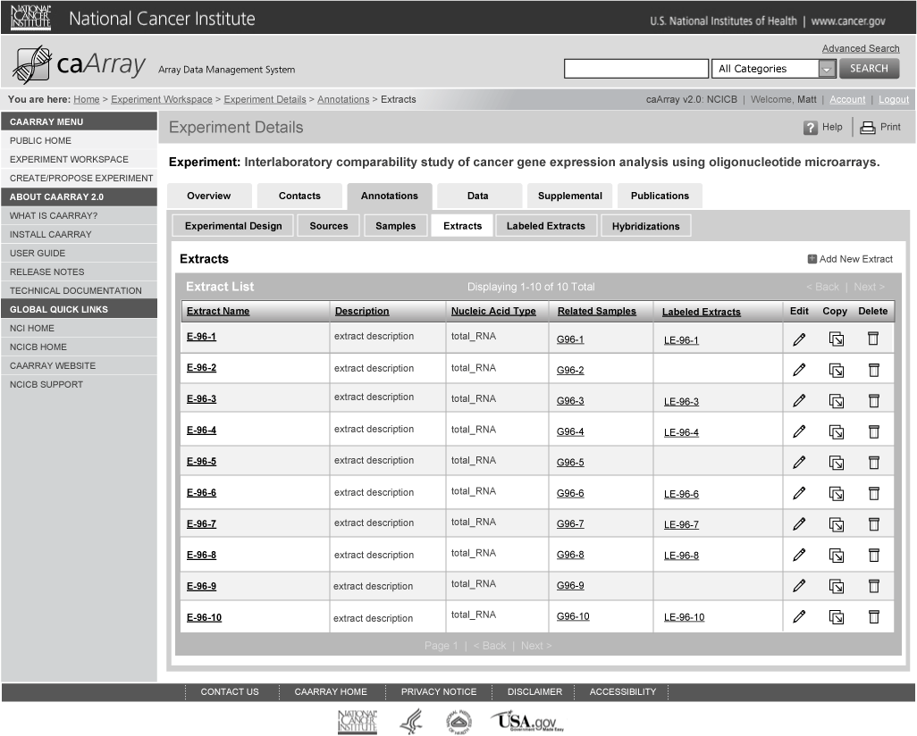
Submit Experiment Proposal: Experiment Data: Extracts List

Slide 25
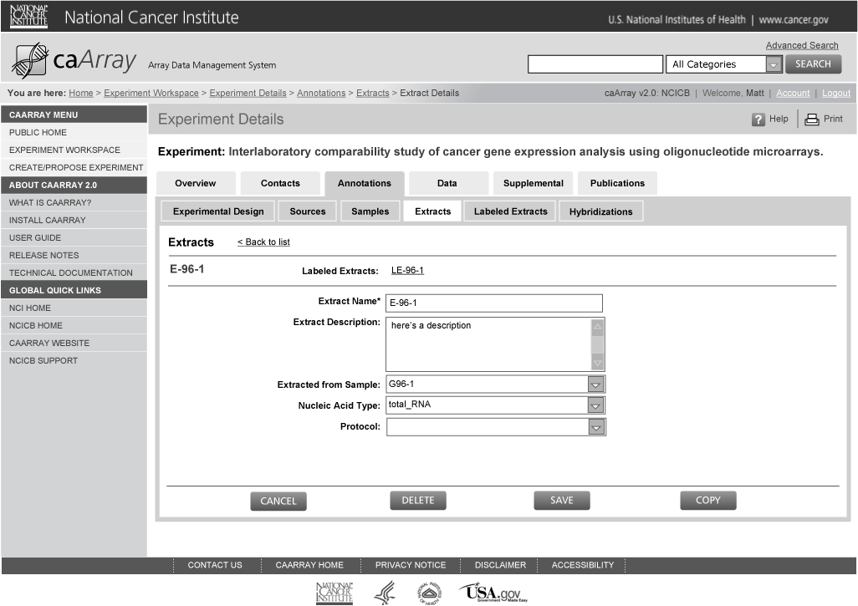
Submit Experiment Proposal: Edit Experiment Data: Extracts

Slide 26
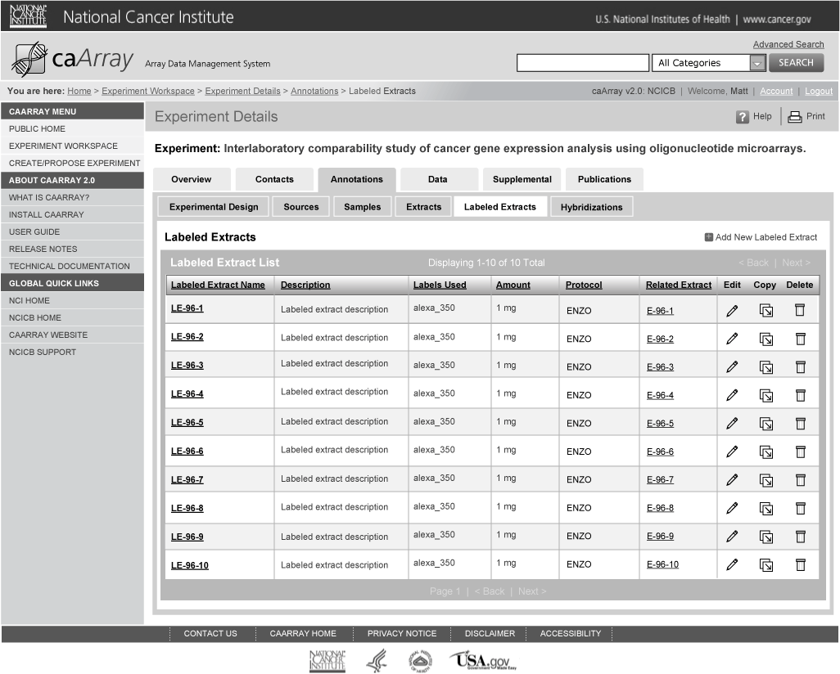
Submit Experiment Proposal: Experiment Data: Labeled Extracts List

Slide 27
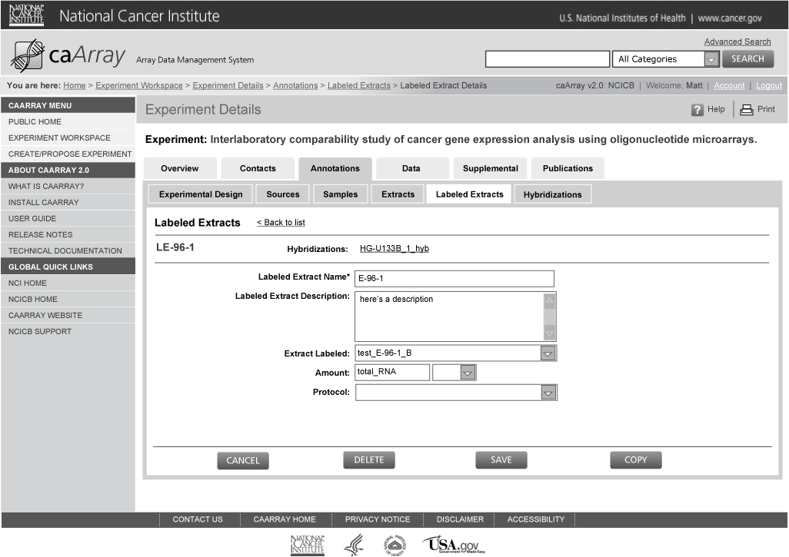
Submit Experiment Proposal: Edit Experiment Data: Labeled Extracts

Slide 28
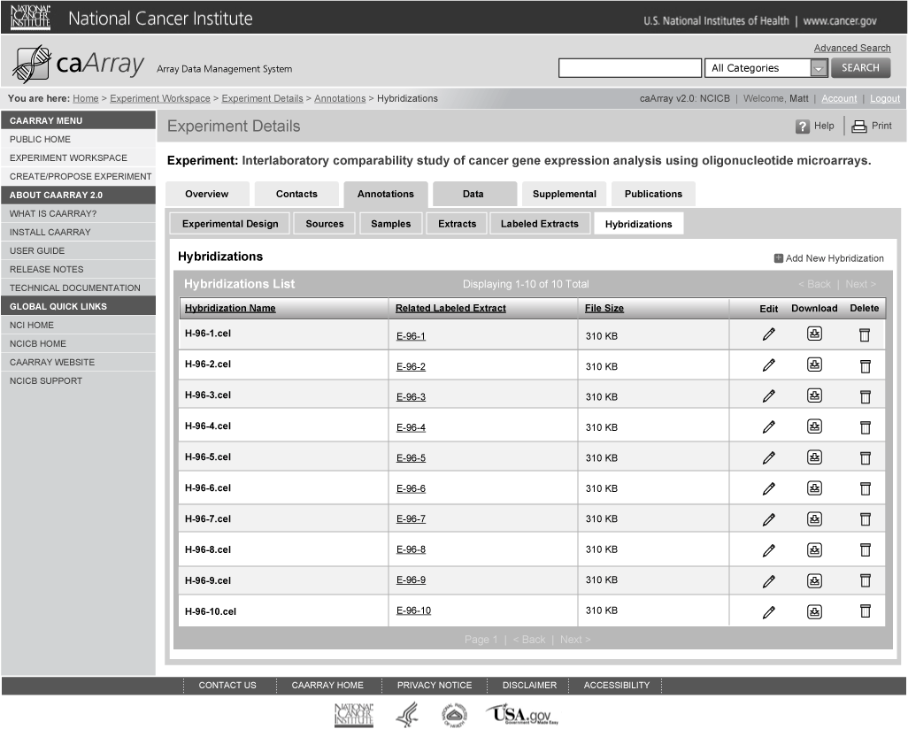
Submit Experiment Proposal: Experiment Data: Hybridizations List

Slide 29

Submit Experiment Proposal: Edit Experiment Data: Hybridizations

Slide 30
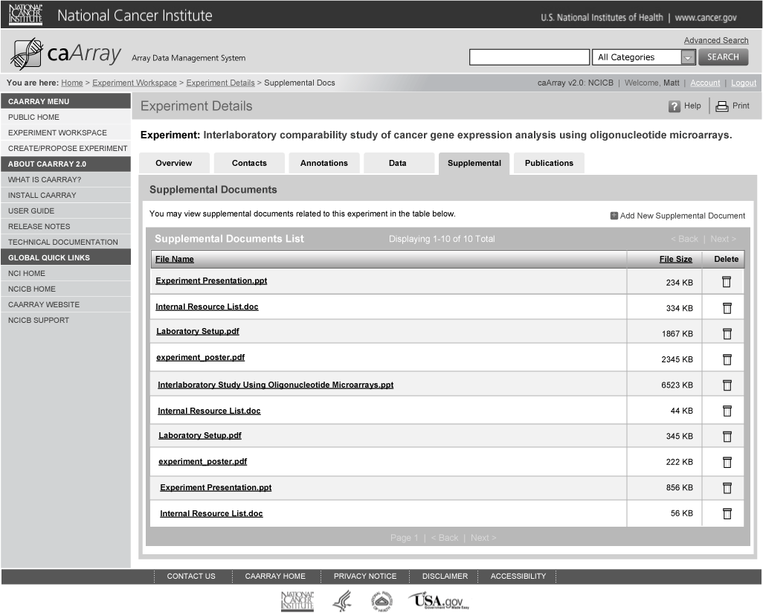
Submit Experiment Proposal: Edit Supplemental Docs

Slide 31
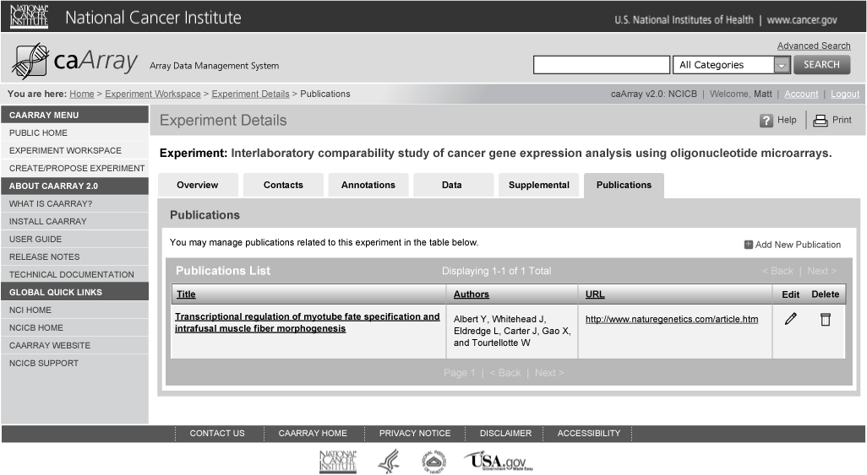
Submit Experiment Proposal: Edit Publications

Slide 32
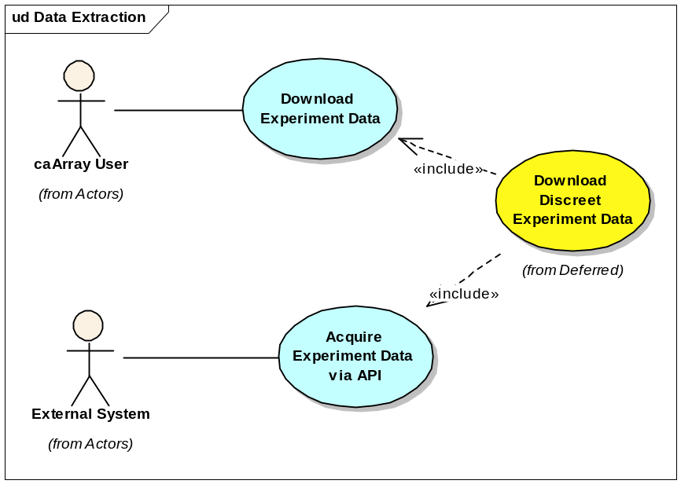
Extraction

Slide 33
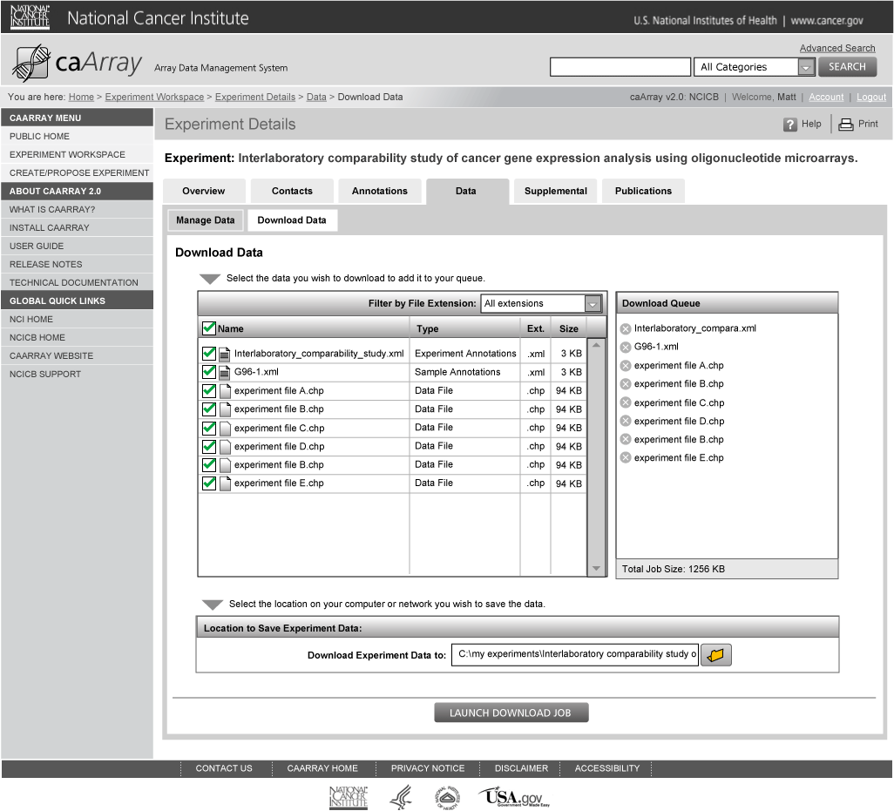
Download Experiment Data: Step 1

Slide 34
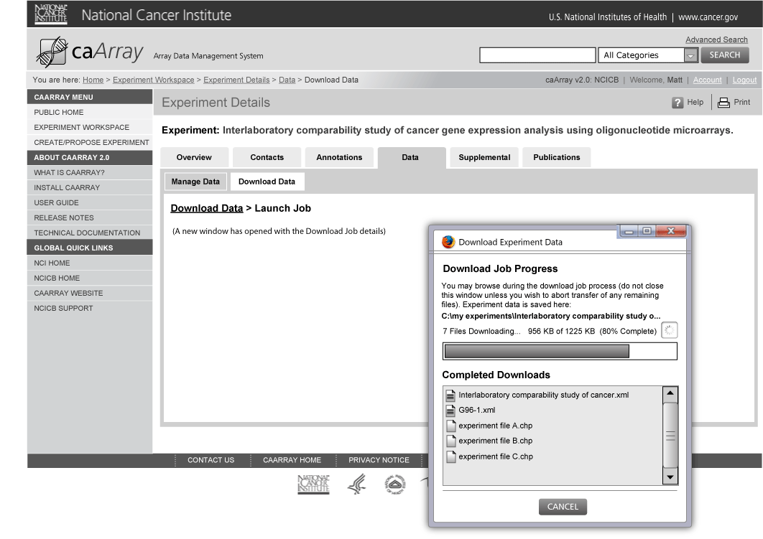
Download Experiment Data: Step 2

Slide 35
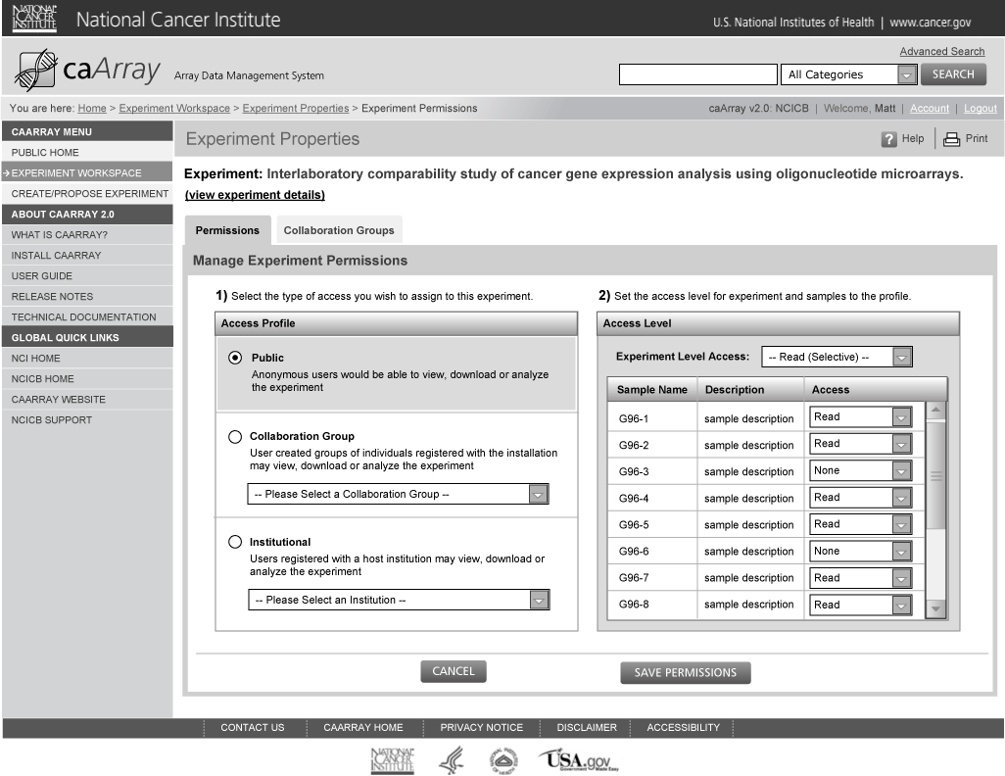
Manage Experiment Permissions

